Slide 1

REACT
16.09.2020
github.com/fdikmen

Slide 2
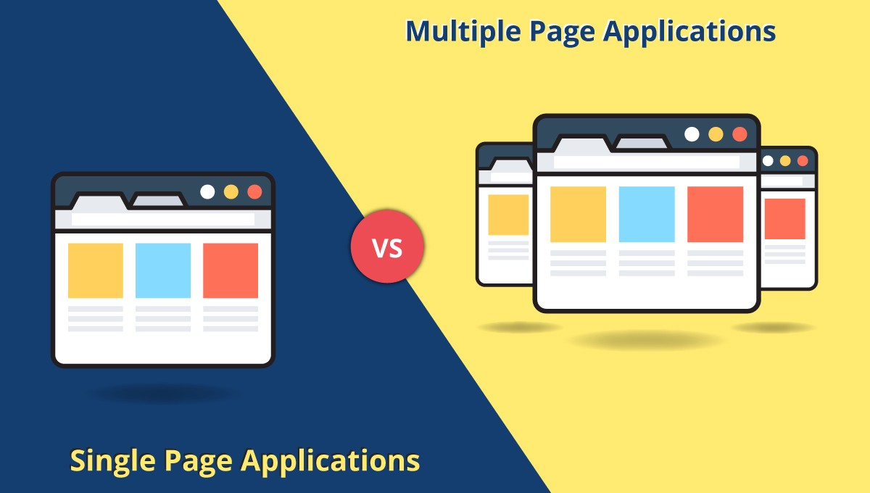

Slide 3
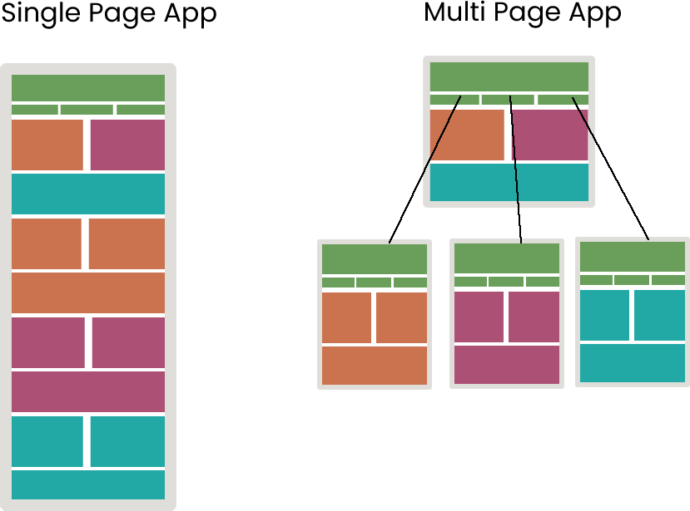

Slide 4
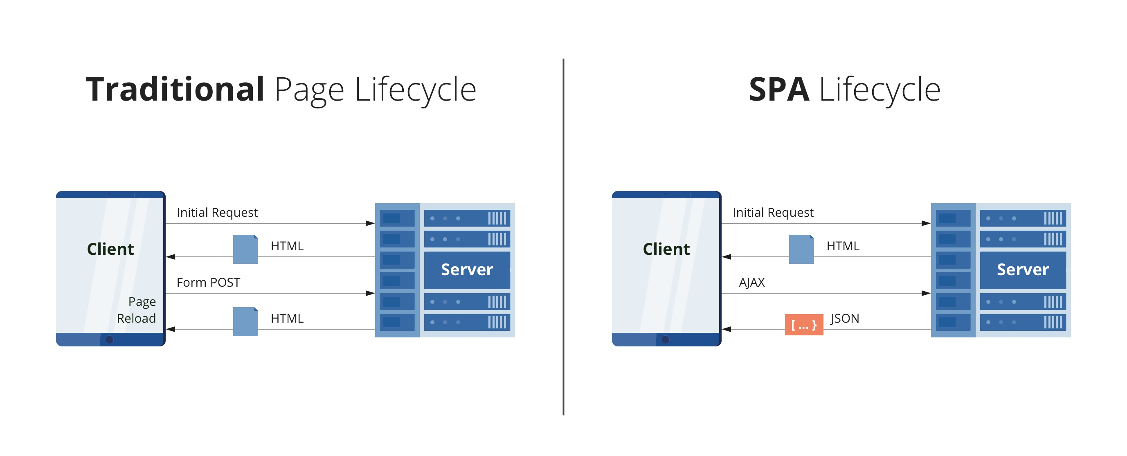

Slide 5
MPA (Multi Page Application)
Advantages
Easy SEO optimization
Easy development
There are too many solutions
Disadvantages
Mobile application development will take much more time.
Web interface and backend development are tightly combined.
Takes longer to develop

Slide 6
SPA (Single Page Application)
Advantages
Faster User Experience
Less Server Resources
Easier to debug
Easier Switching to Other Applications
Disadvantages
Lower First Load Times
SEO Challenges
Security problems
Memory leaks

Slide 7
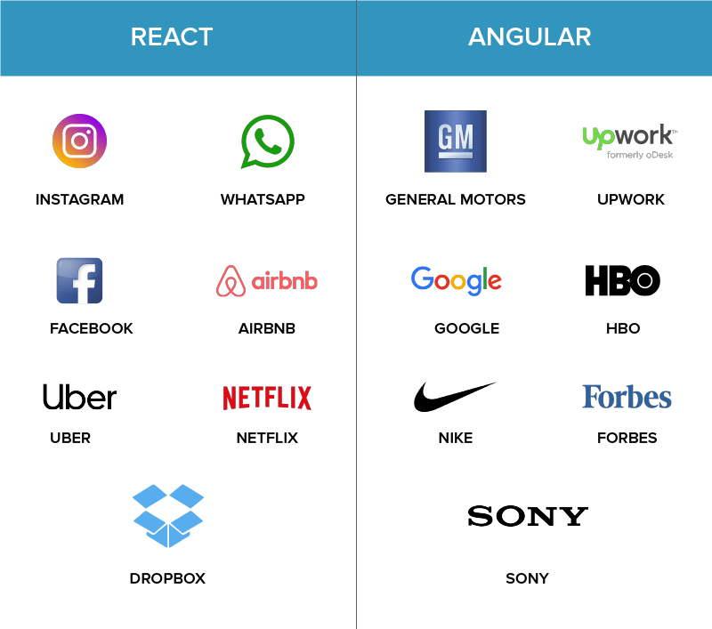

Slide 8
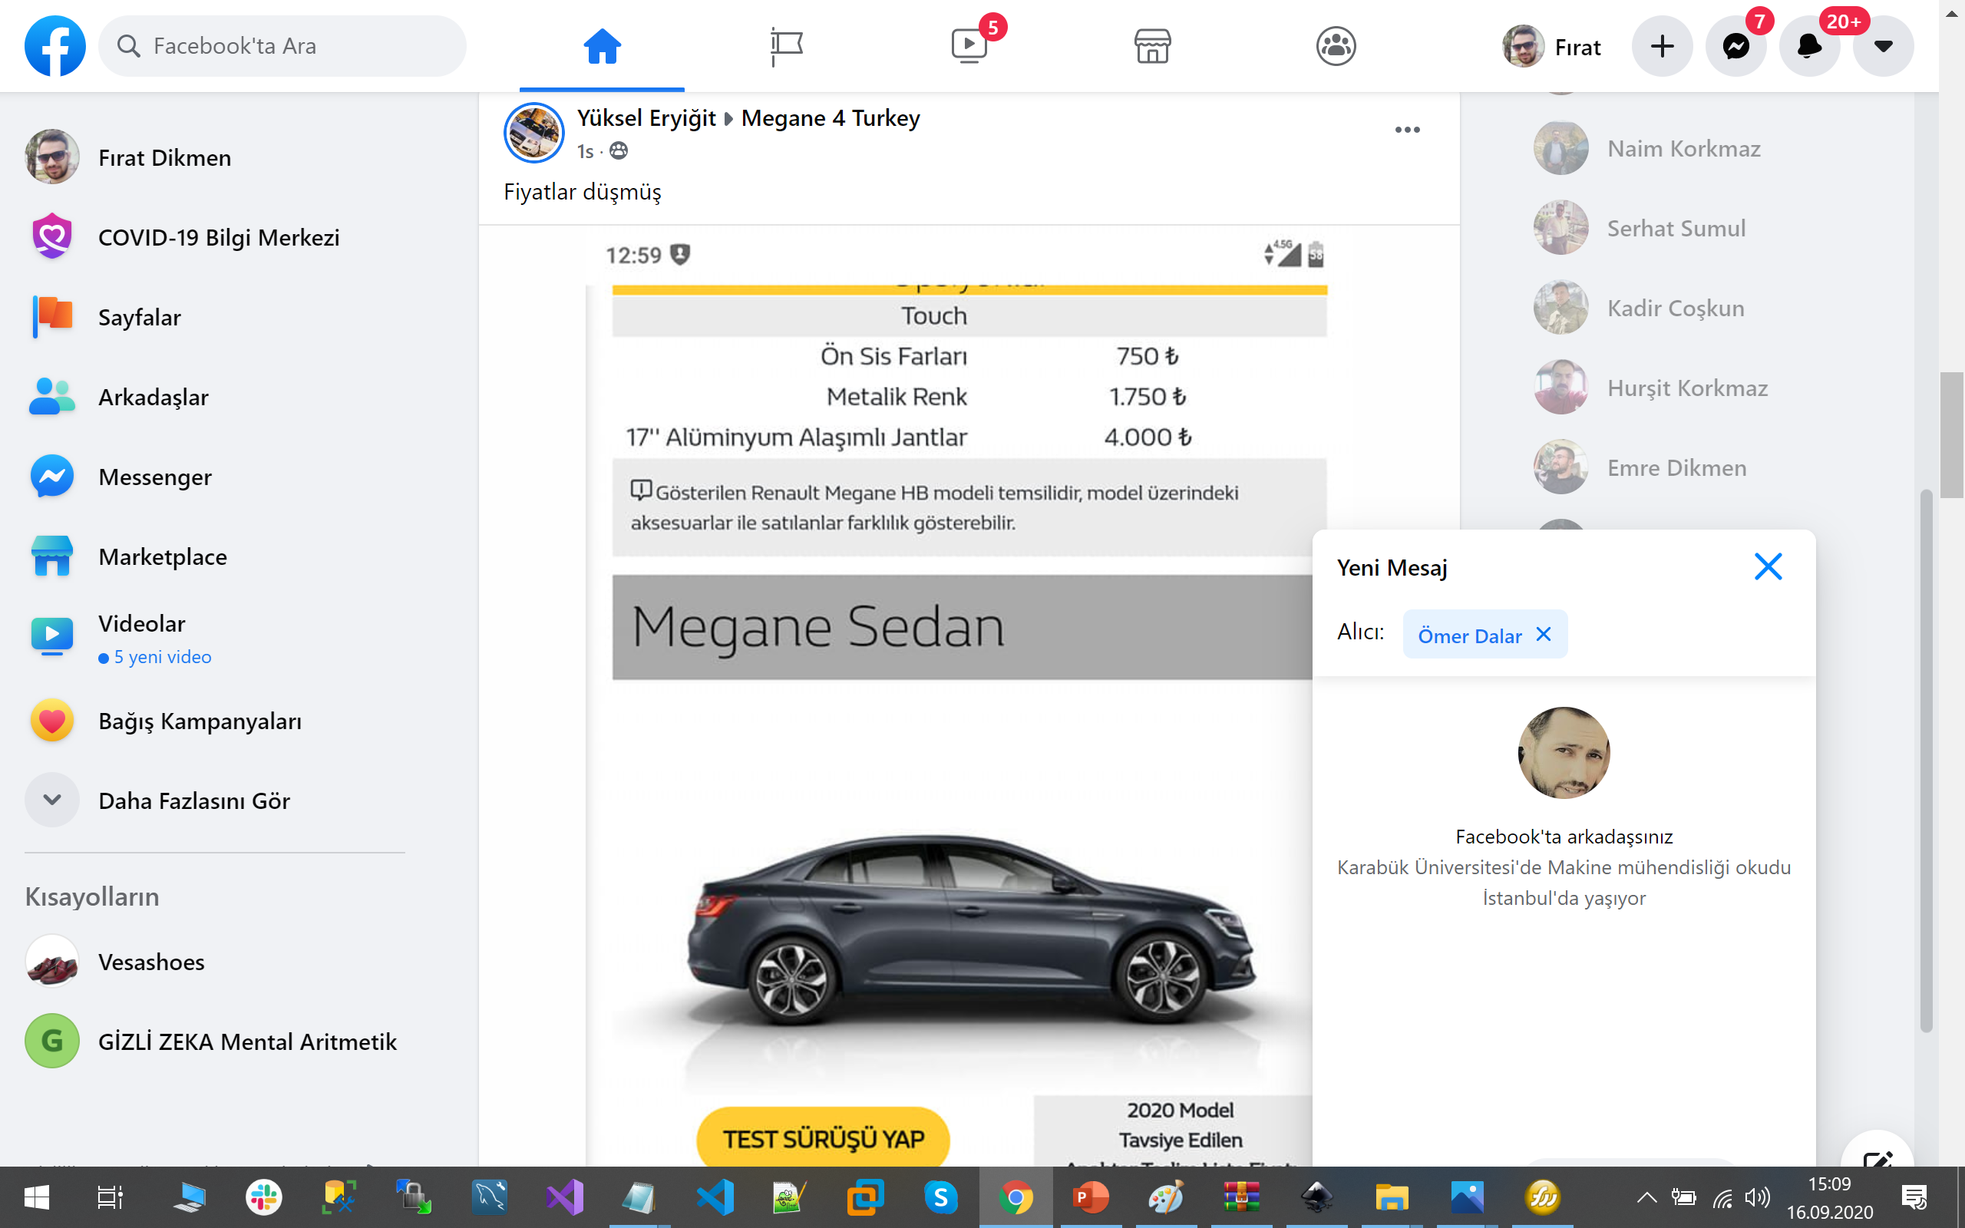

Slide 9
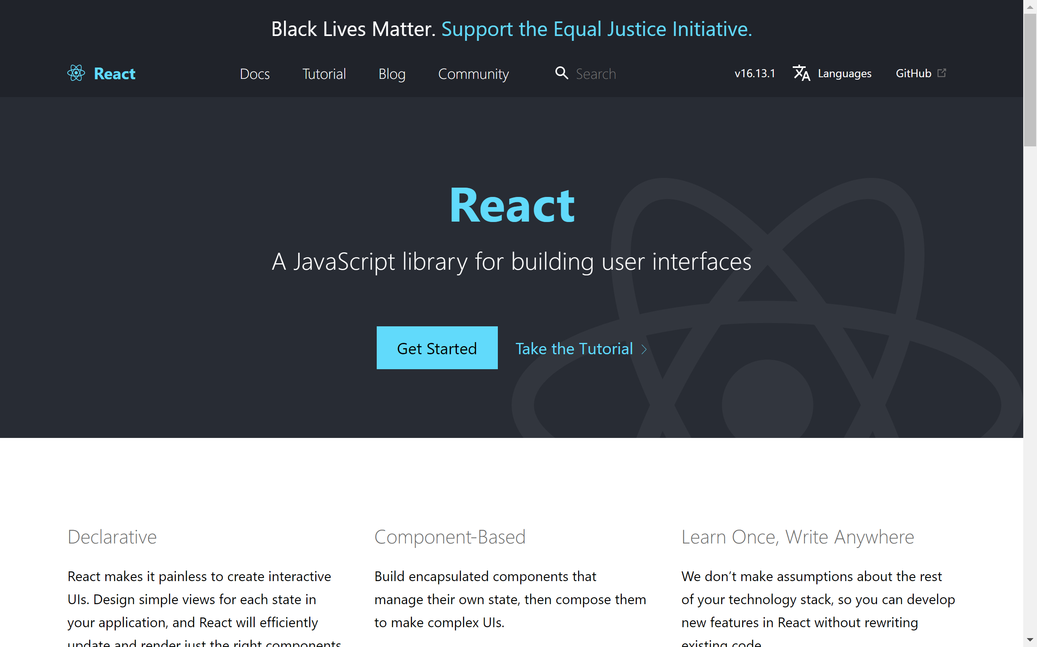

Slide 10
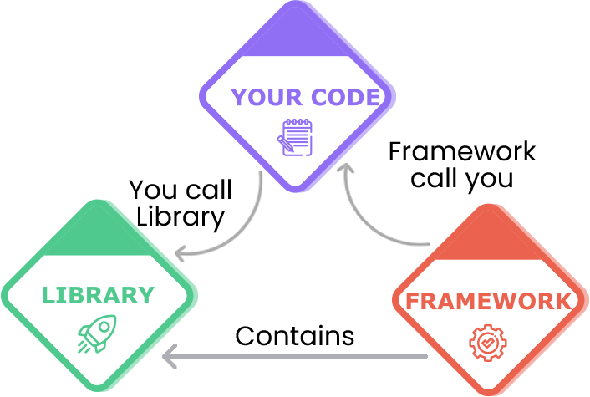
Framework vs Library

Slide 11
Framework vs Library
Library
Framework
Jquery
Image Processing: OpenCV
Graphics Library: OpenGL
React
.Net MVC
Game Framework: Unity
Application Framework: Spring
Angular

Slide 13
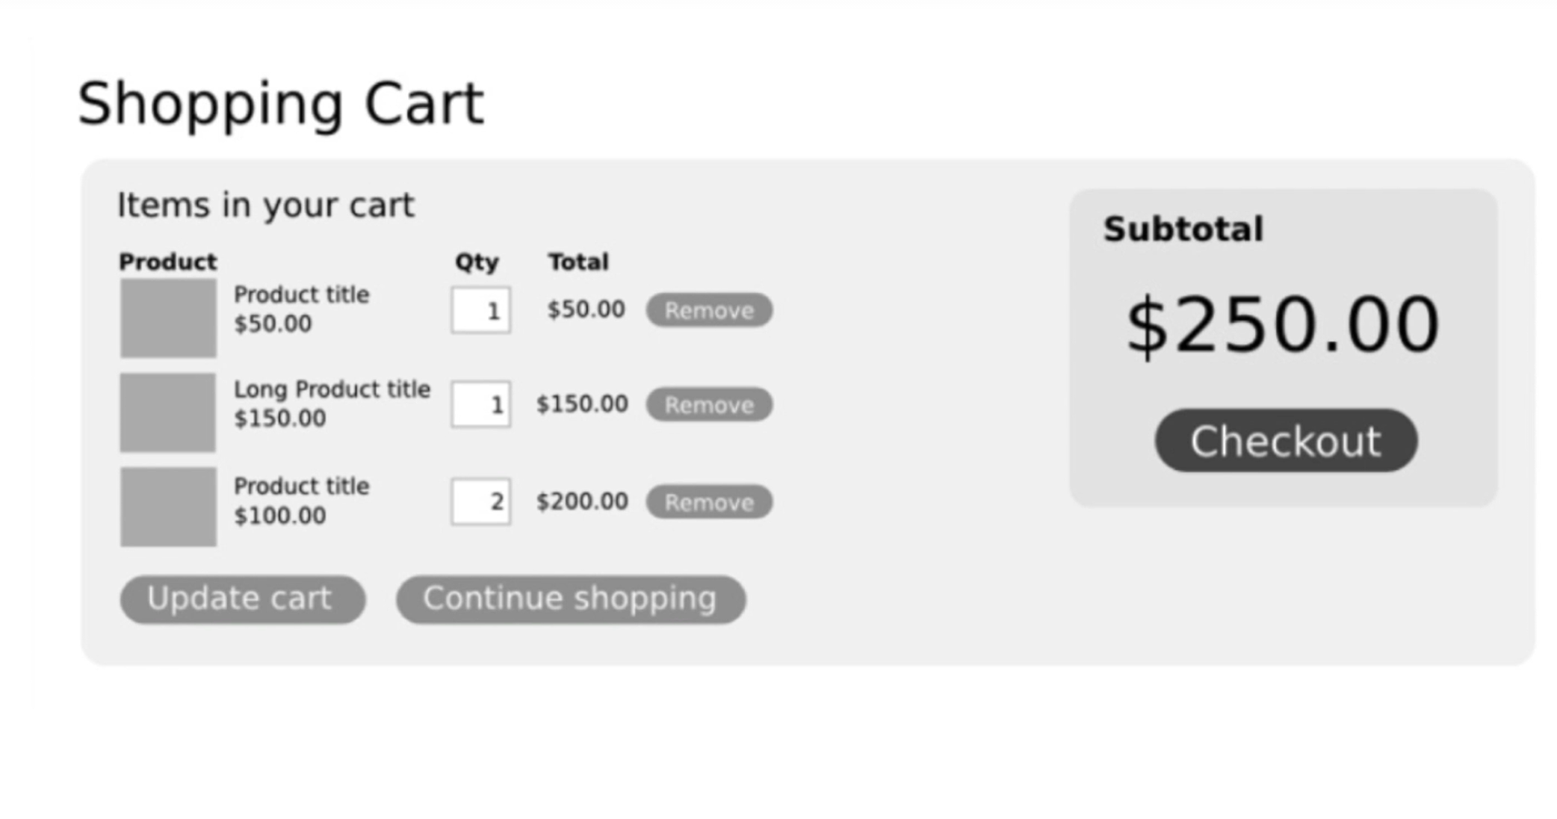
Component?

Slide 14
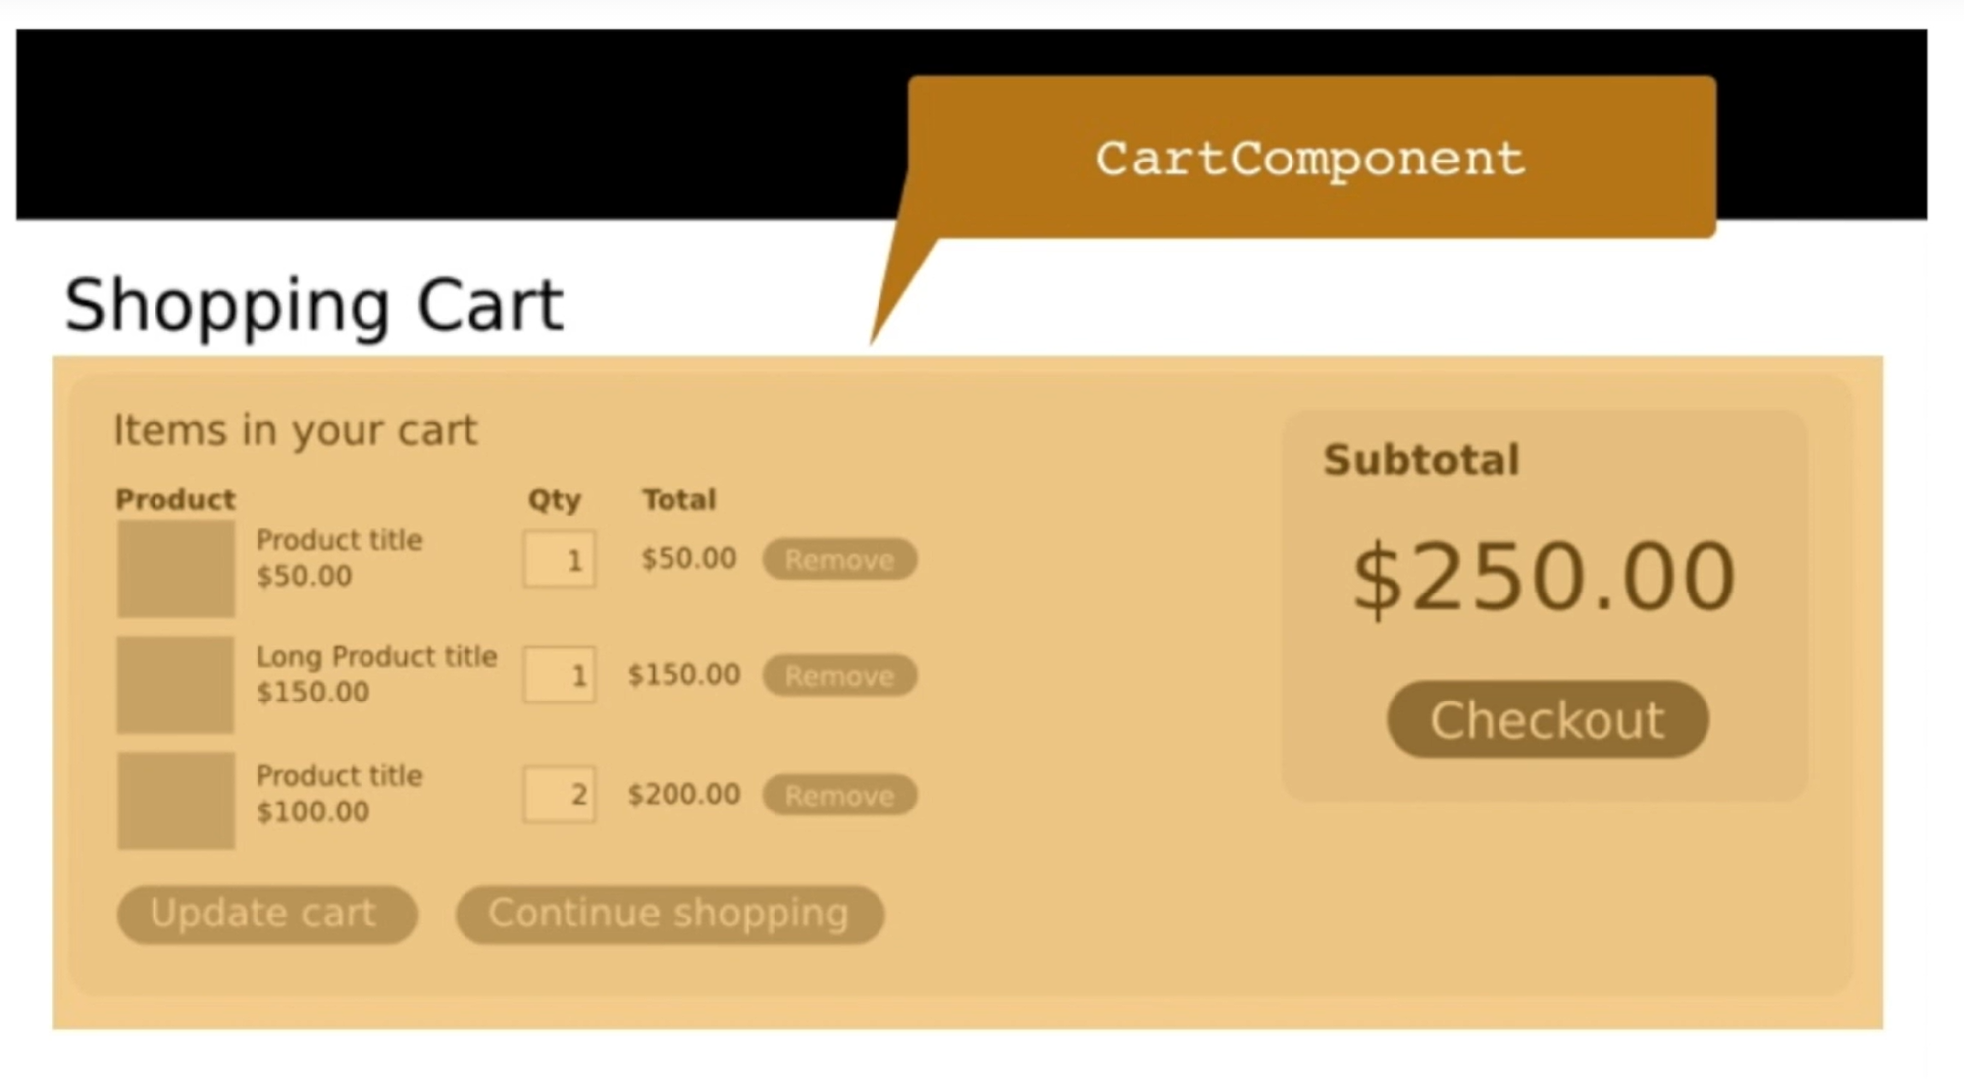
Component?

Slide 15
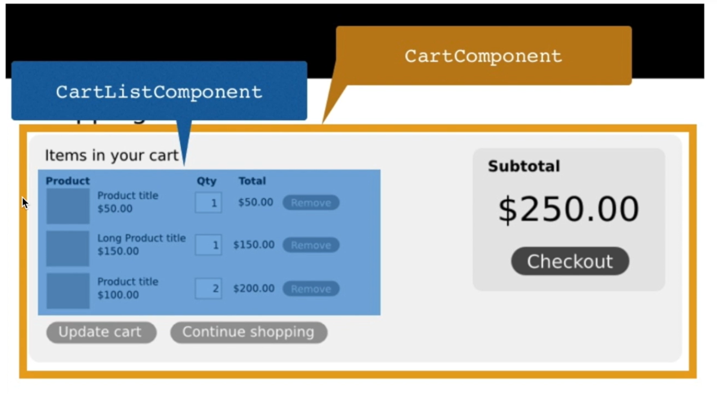
Component?

Slide 16
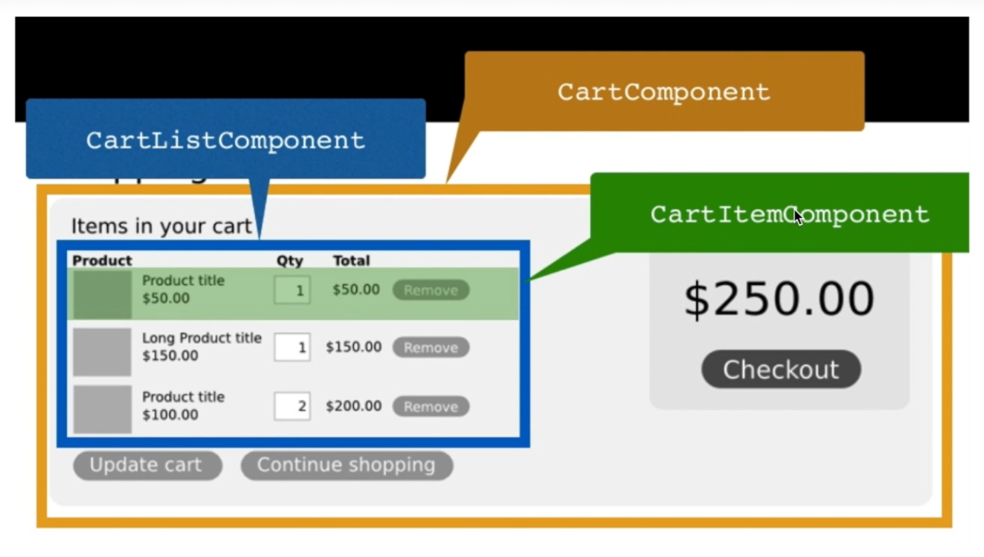
Component?

Slide 17
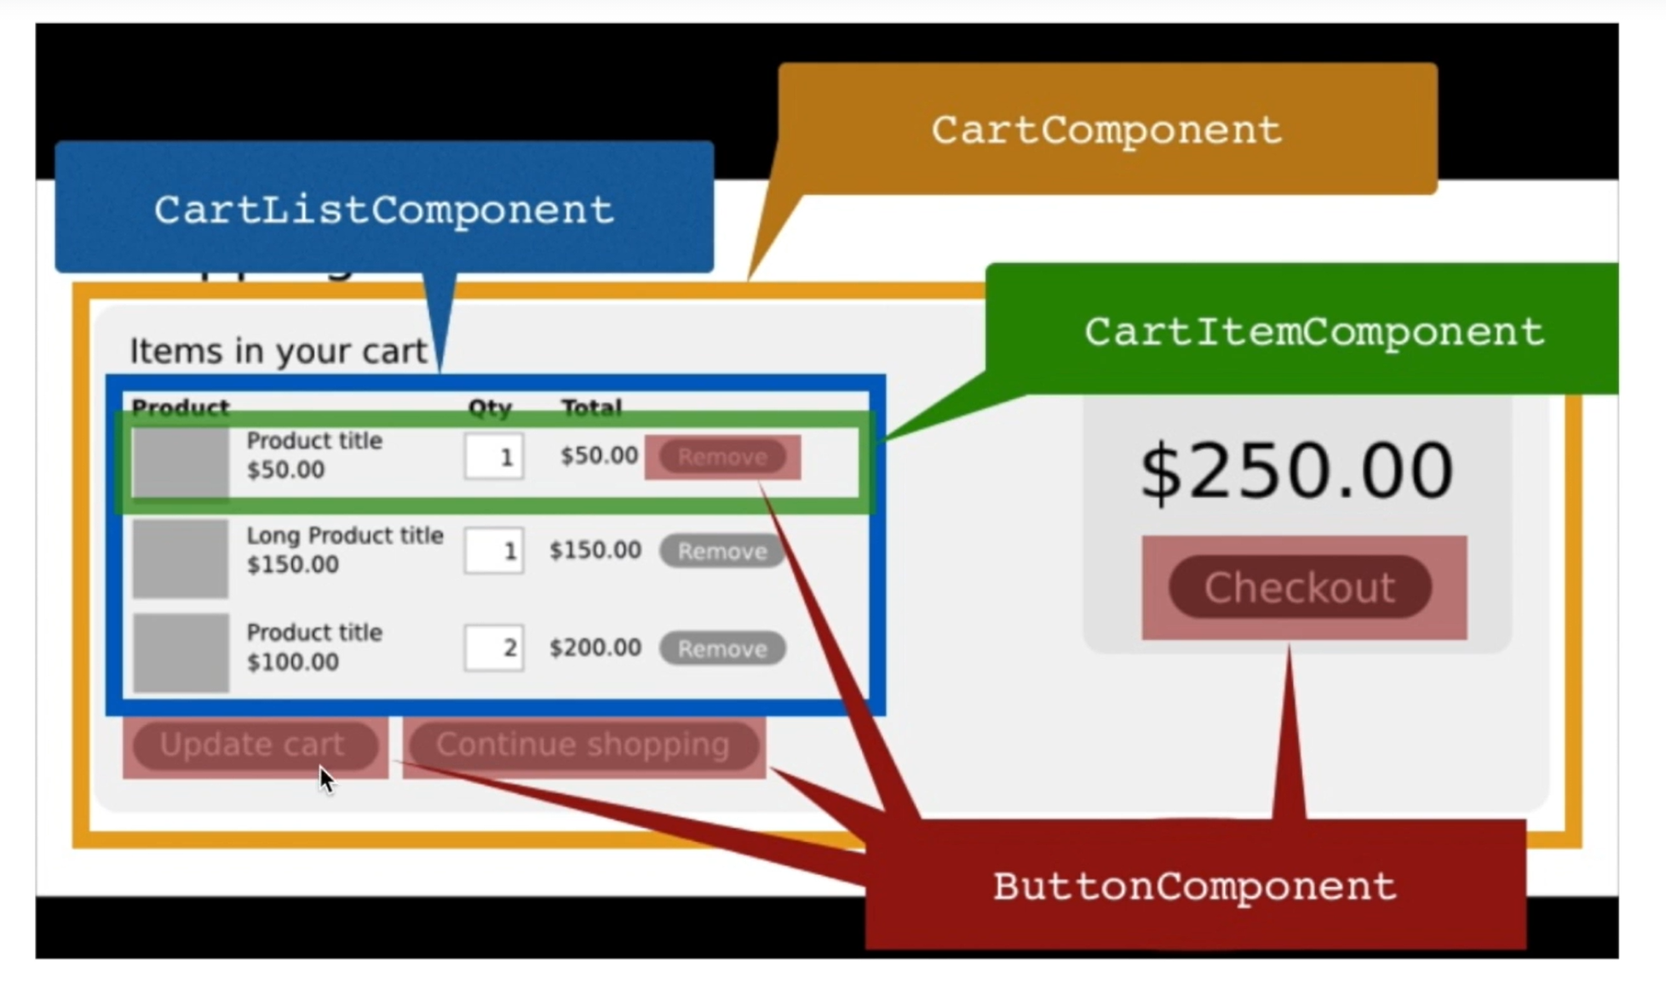
Component?

Slide 18
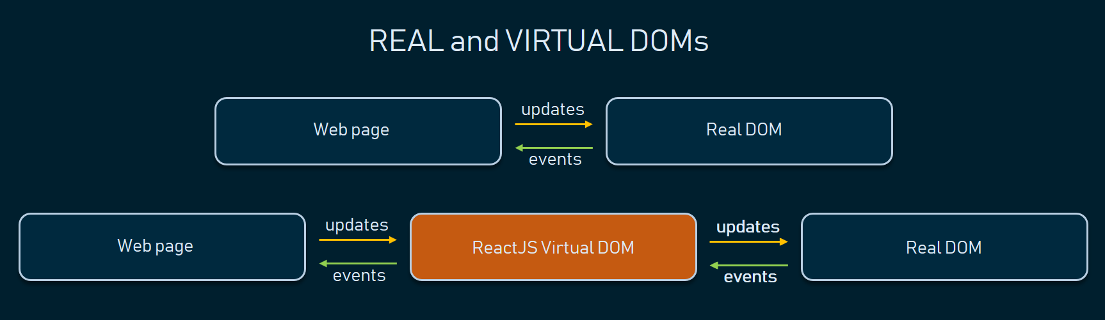

Slide 19
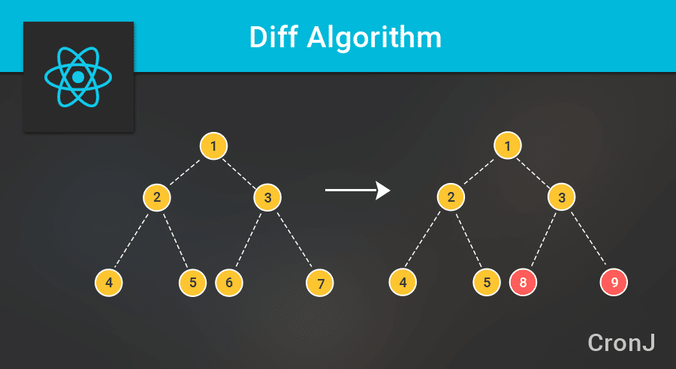

Slide 20
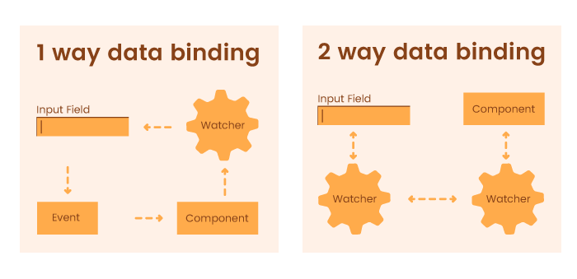
One Way Data Binding vs Two way Data Binding

Slide 21
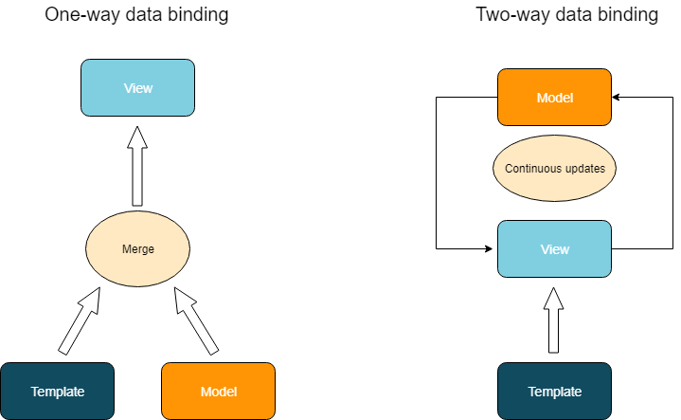

Slide 22

When to Use React?

Slide 23
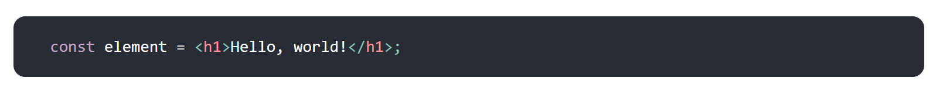
What is JSX?

Slide 24
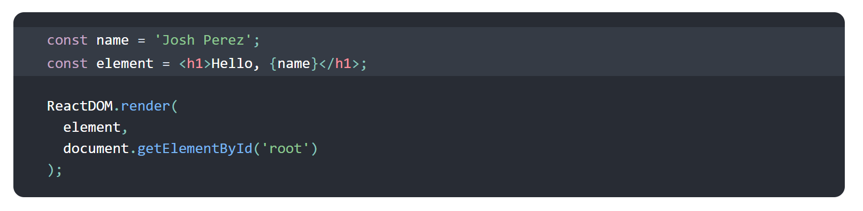
What is JSX?

Slide 25
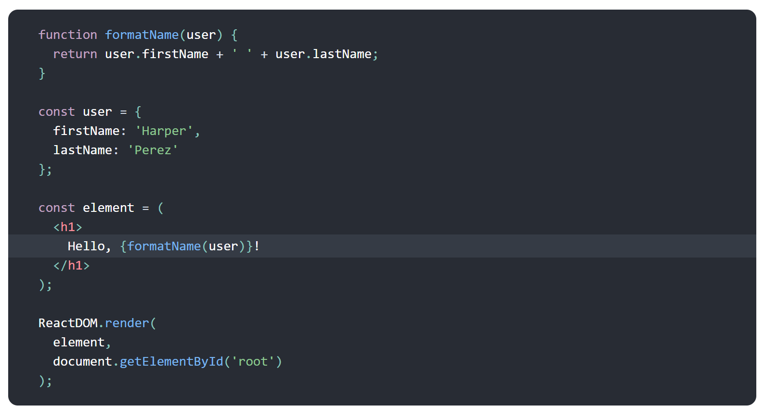
Using JavaScript in JSX

Slide 26
Defining Properties with JSX

Slide 27
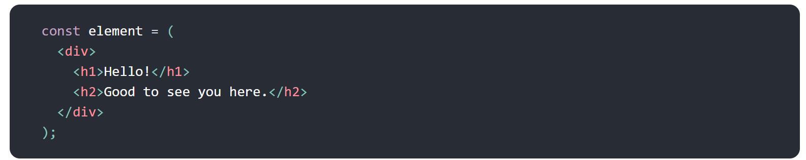
Defining Sub-Elements with JSX

Slide 28
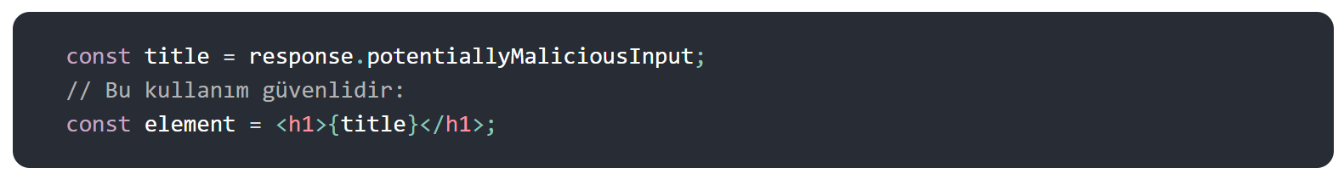
JSX Prevents Injection-XSS Attacks
< & -> &lt; &amp;

Slide 29
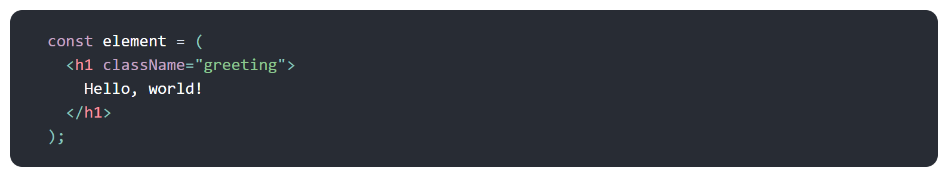
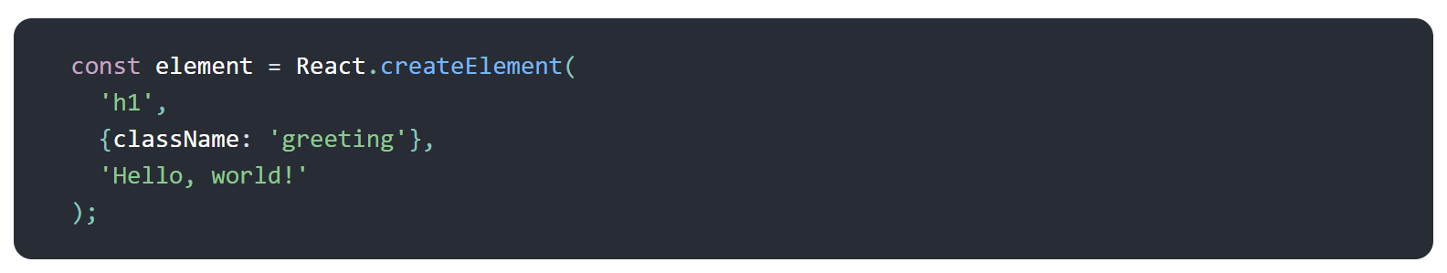
JSX Represents JavaScript Objects

Slide 30
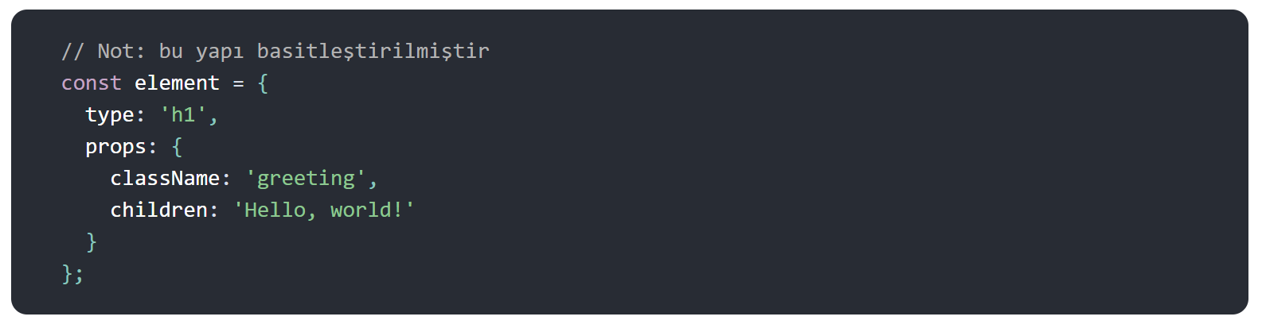
JSX Represents JavaScript Objects

Slide 31
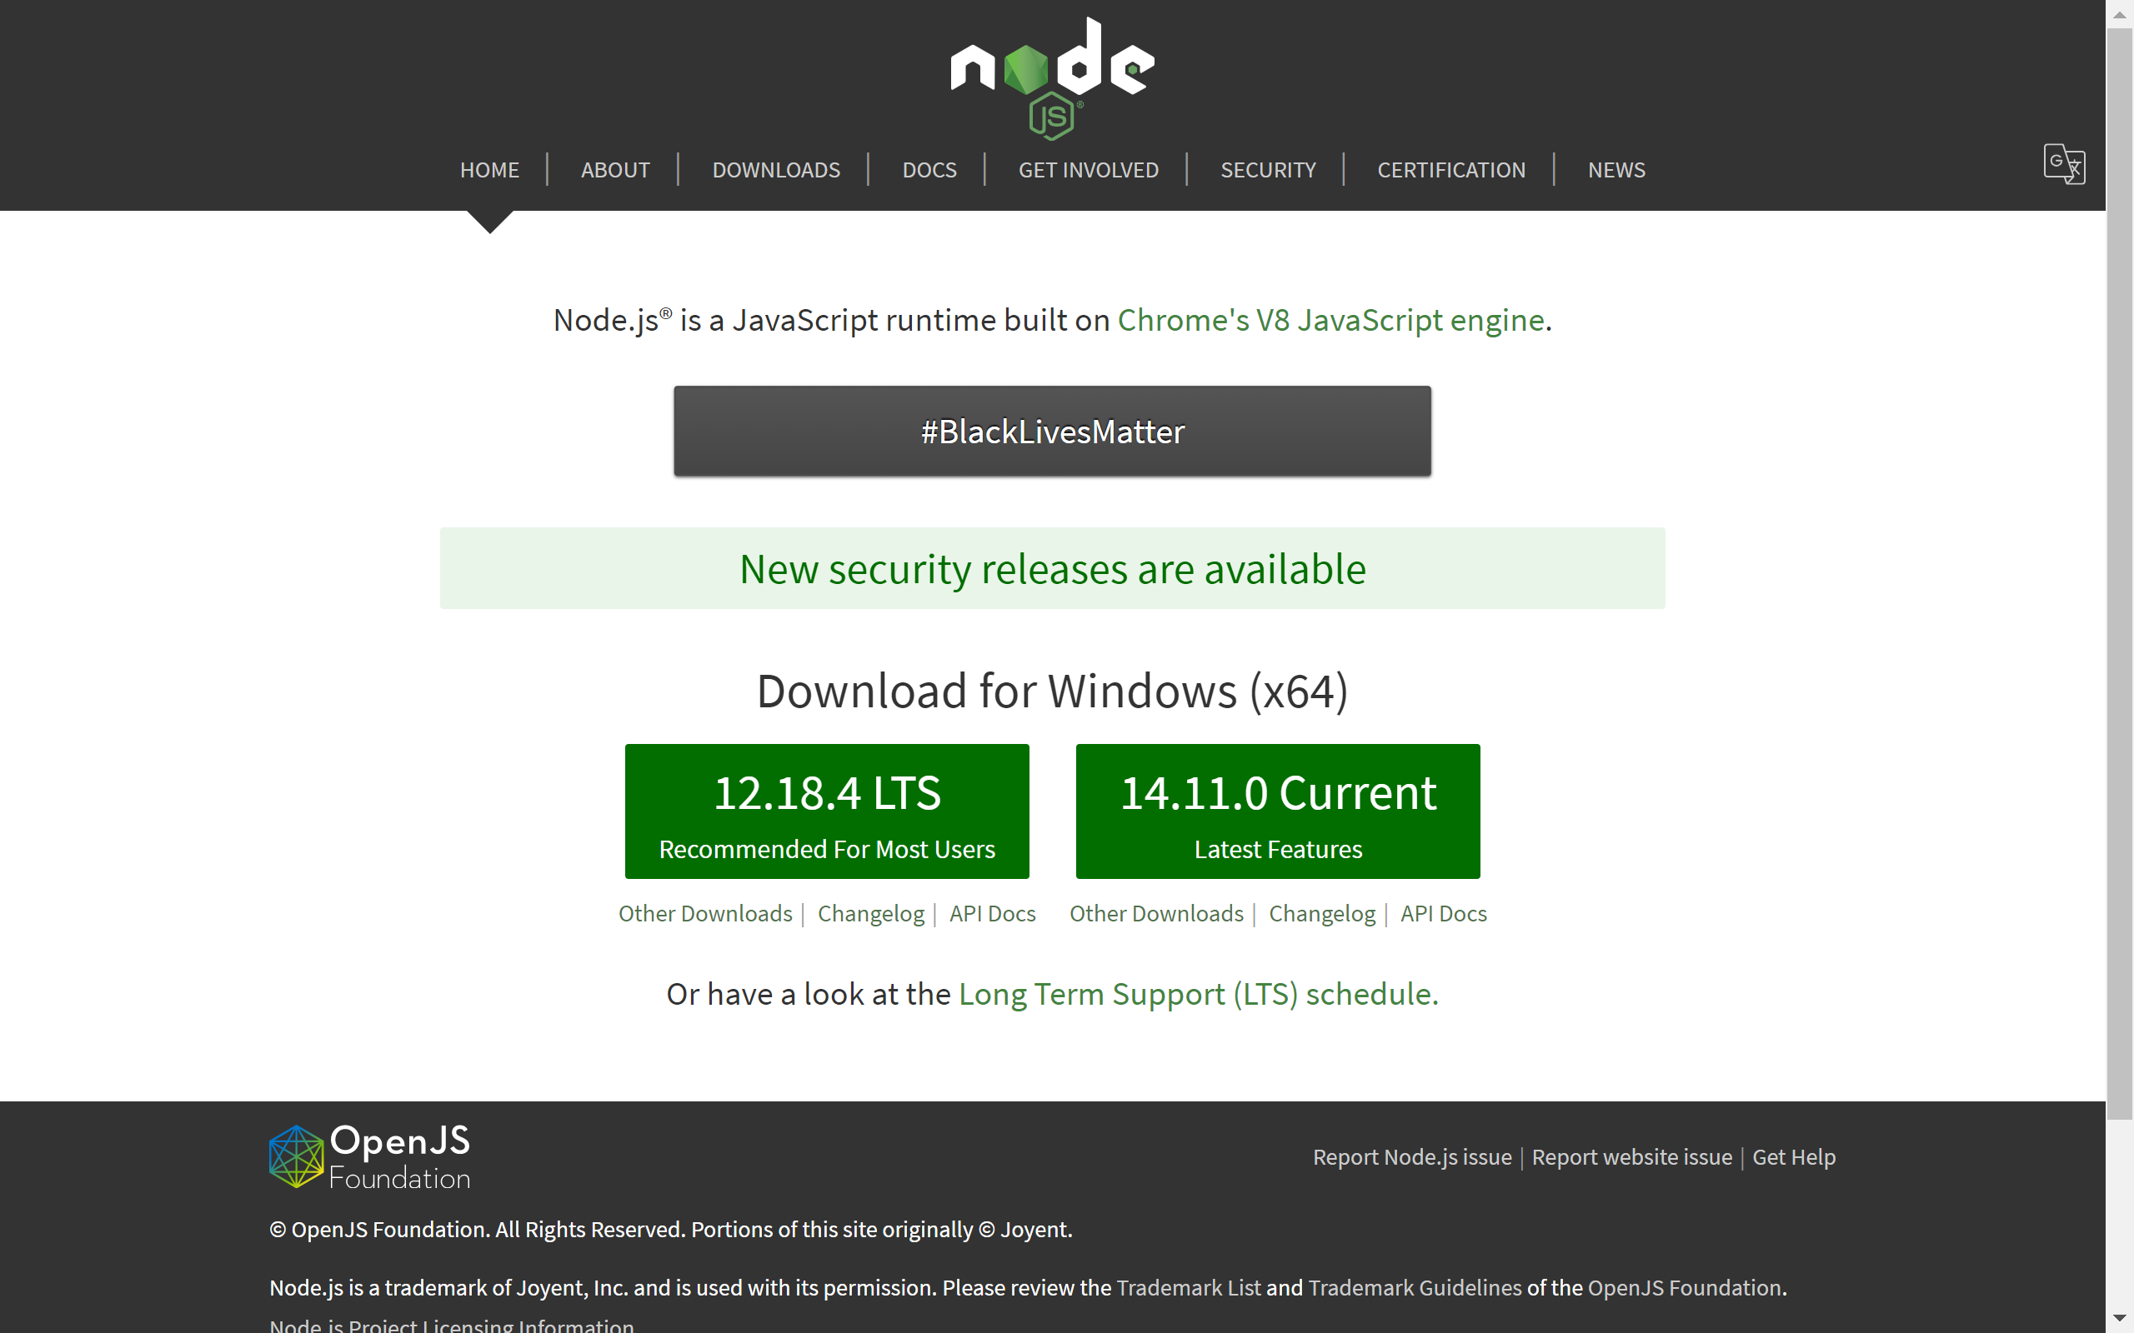

Slide 32
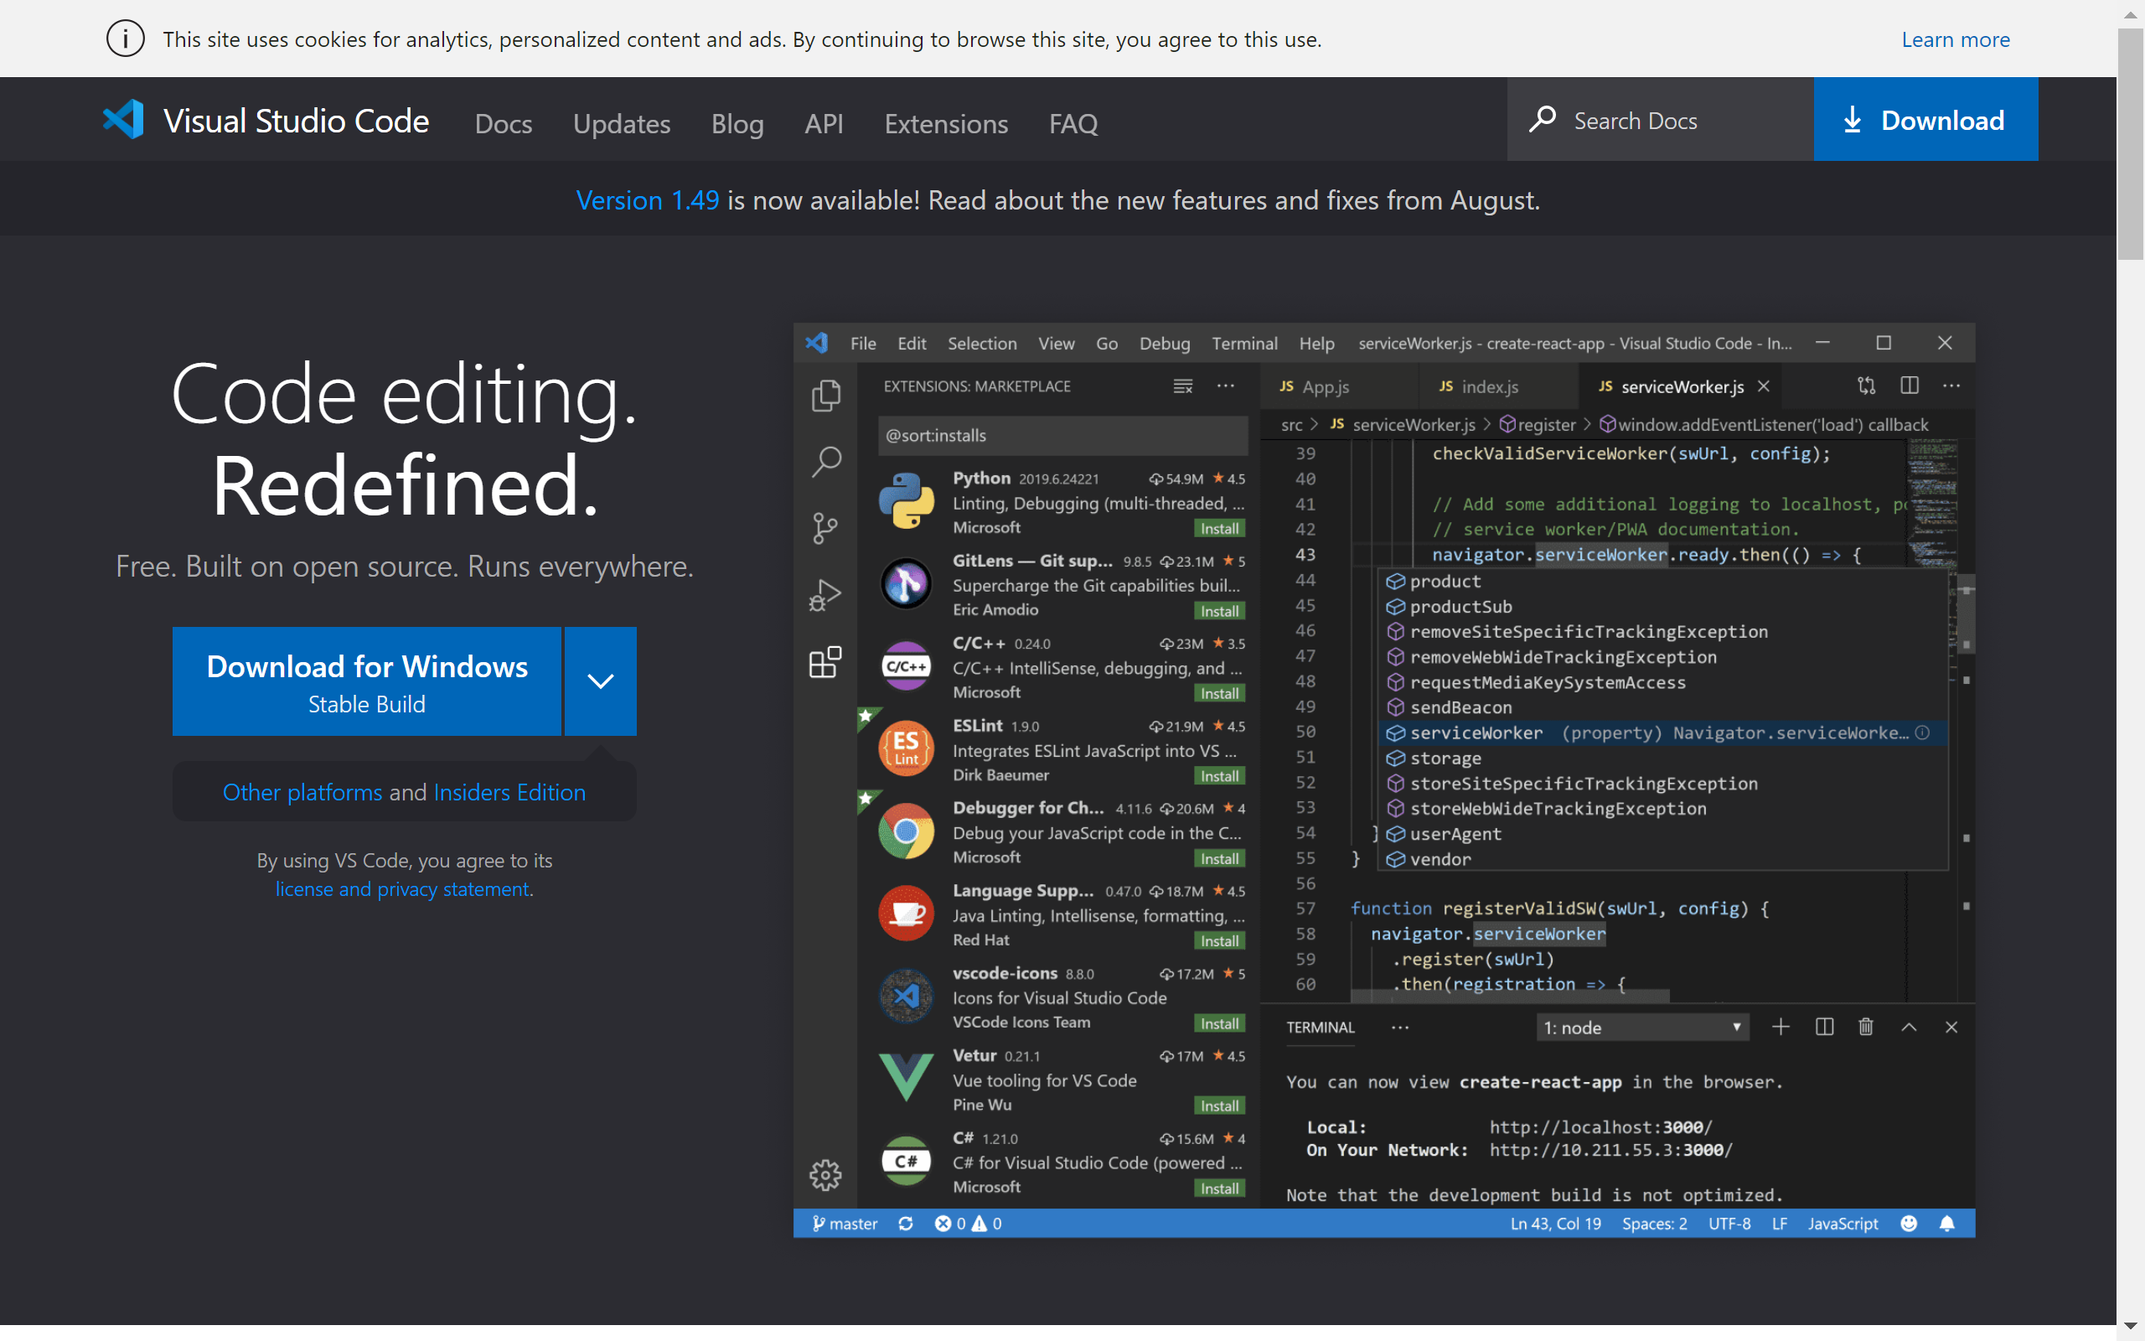

Slide 33
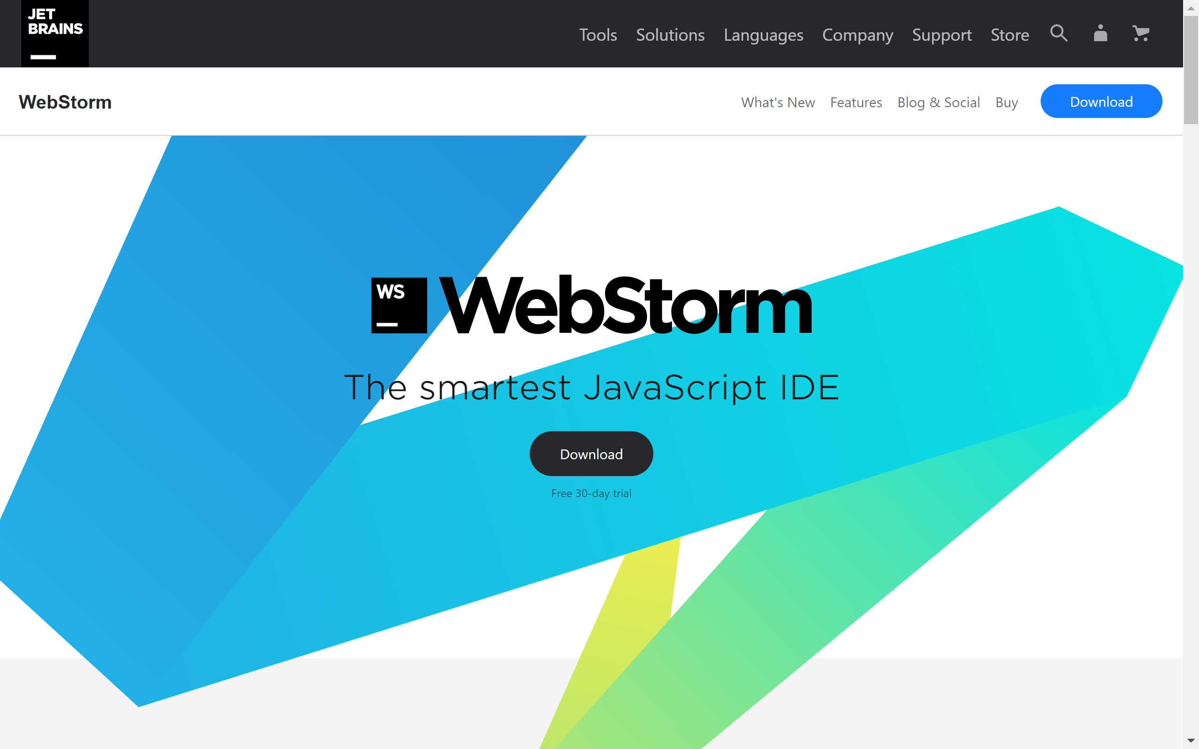

Slide 34
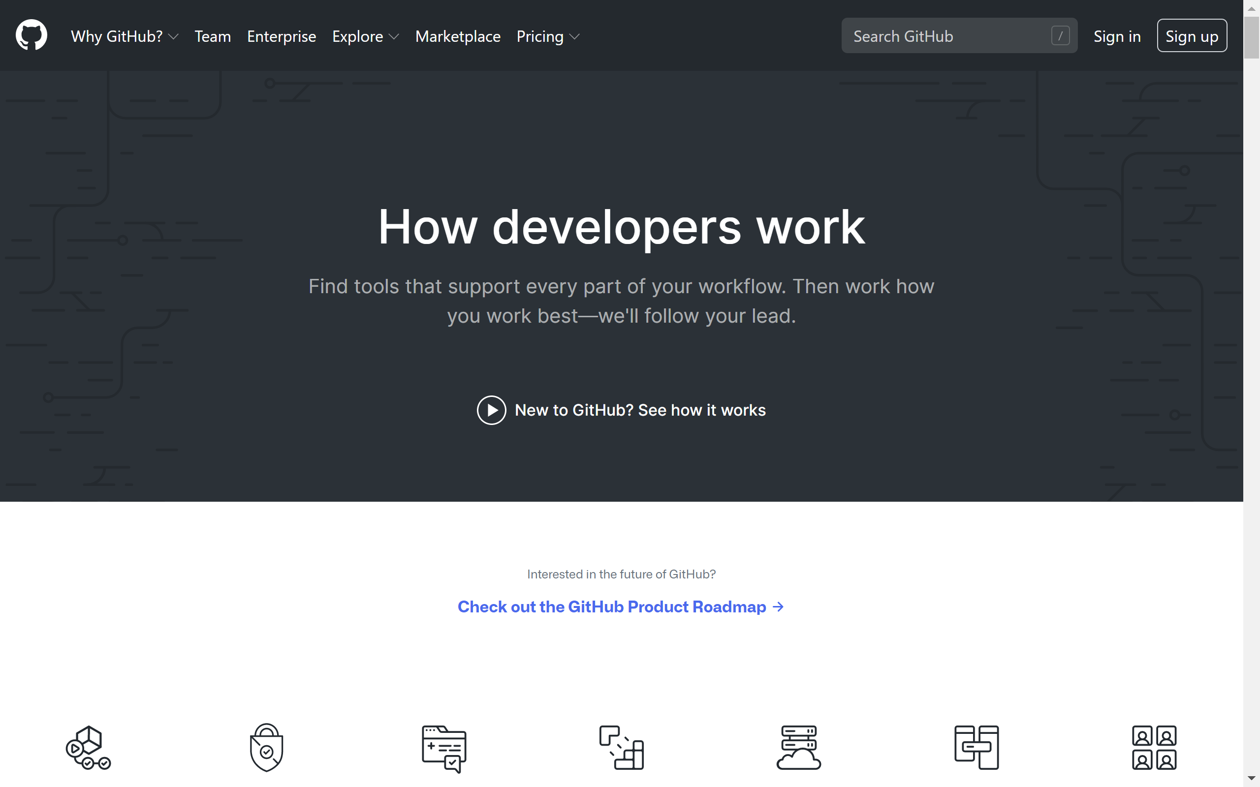
Notes:
Eğitim boyunca yazılan kodları GitHub Reposunda paylaşacağım. Eğitim başlayınca adresini sizlerle paylaşacağım.

Slide 35
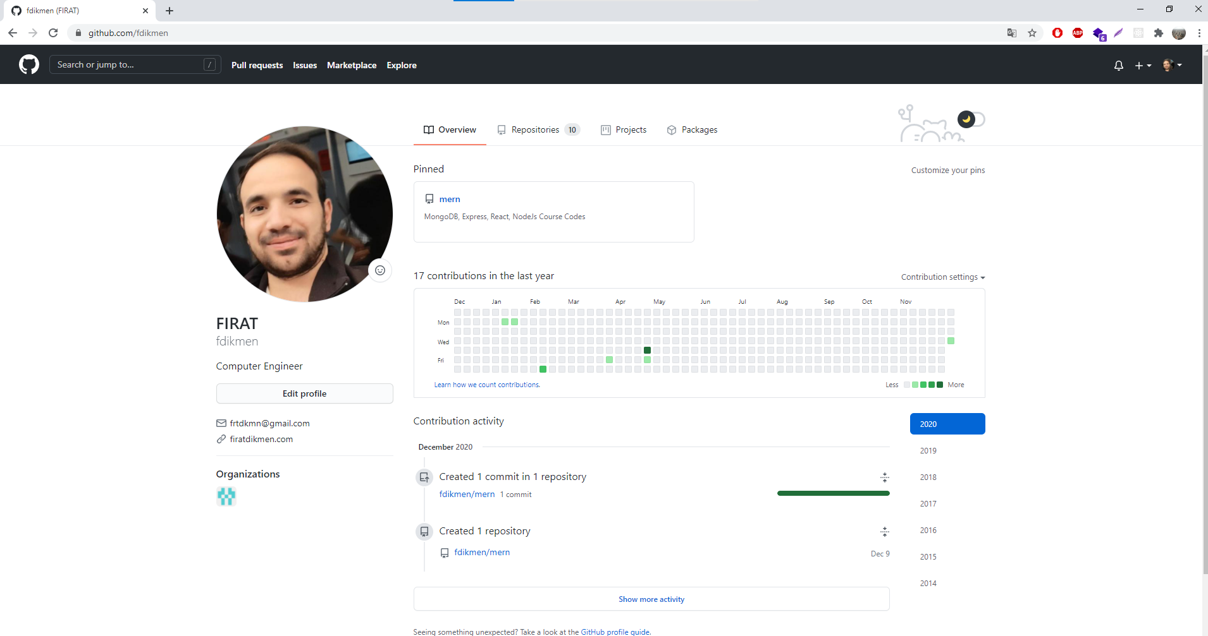
github.com/fdikmen

